Slide 1
CARRO

Slide 2
Problem
So many people are facing parking issues in metropolitan cities like Banglore , Delhi , Hyderabad , Mumbai ,Chennai.
They are facing parking issues in Shopping Malls , Restaruants , Theaters ,Hospitals.
People are waiting for so much time for car parking.
Approximately 90 million people are facing this problem.

Slide 3
solution
We came with an app named ” CARRO”.
Here in this app we can book our parking slot in respective places from any where .
It helps to reduce the waiting time
We can book slot atleast 1 hour before.

Slide 4
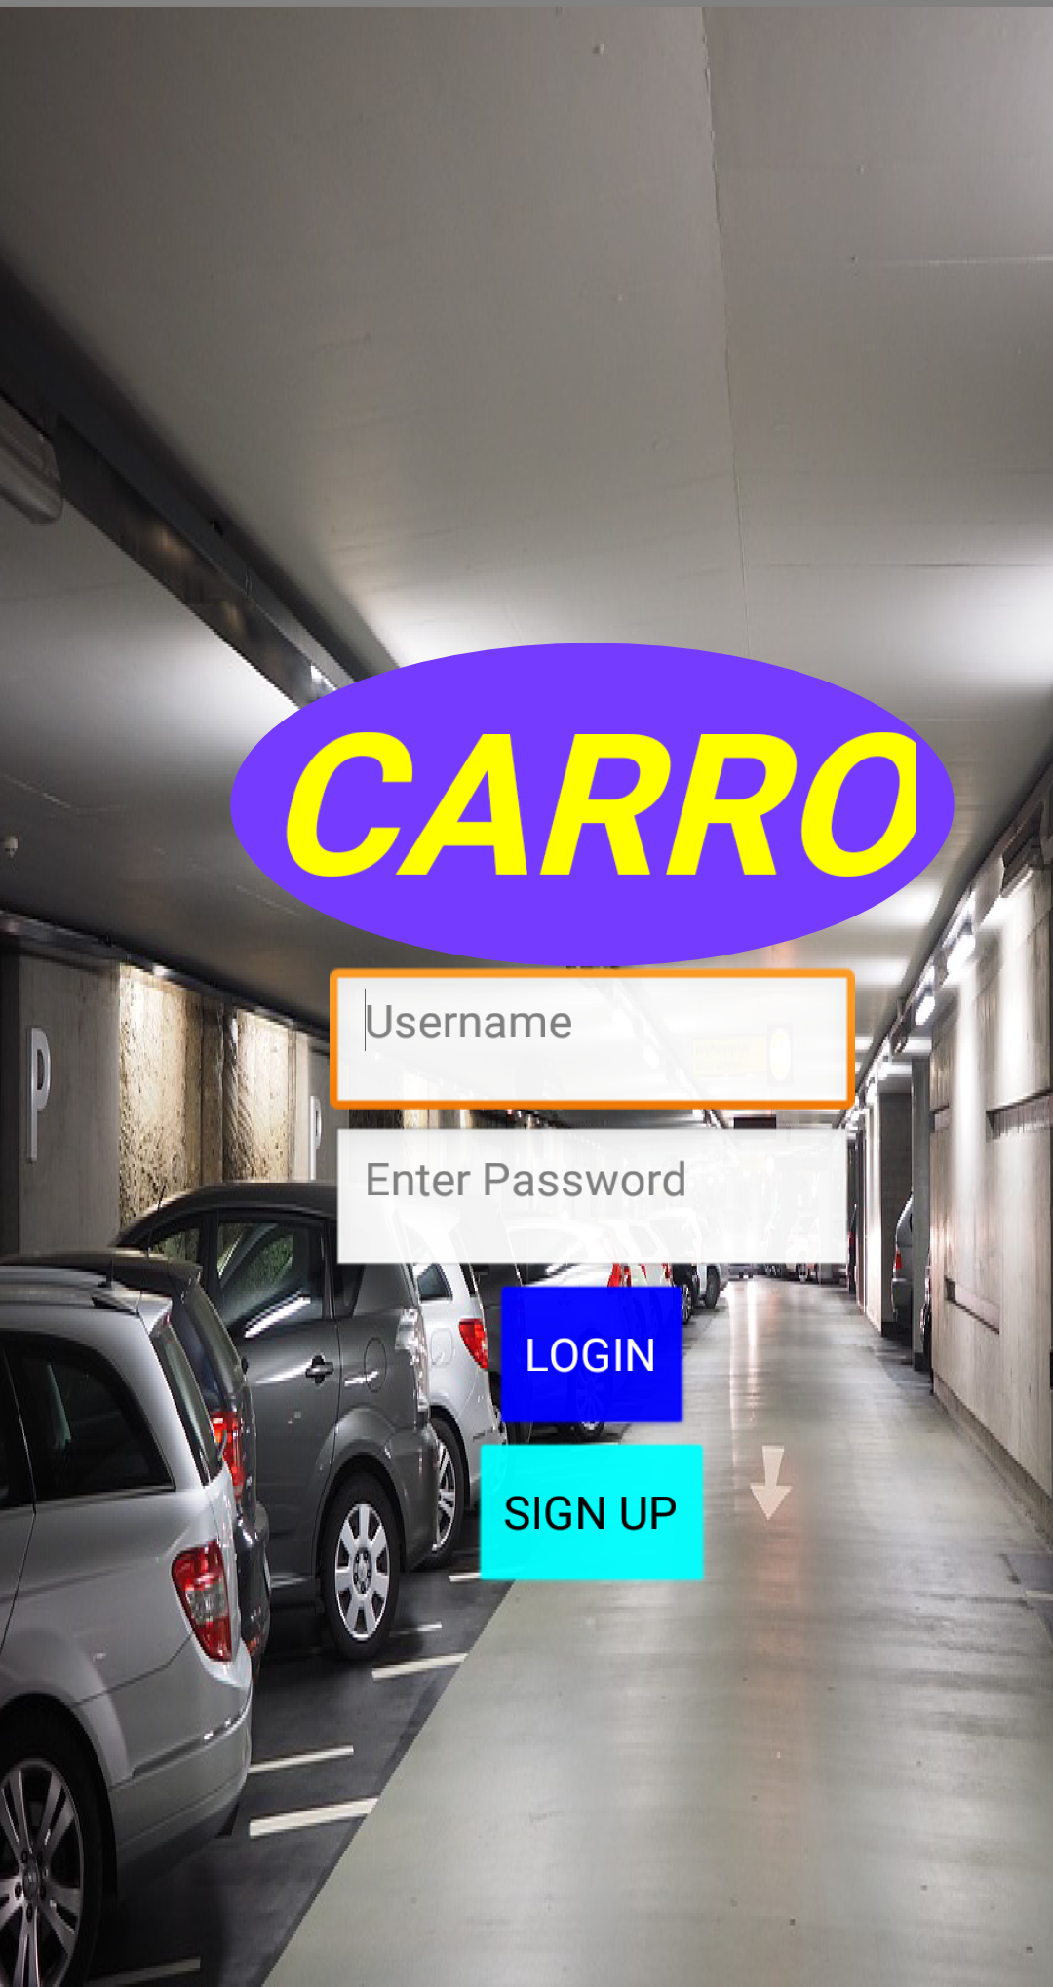
Here we can login in this app

Slide 5
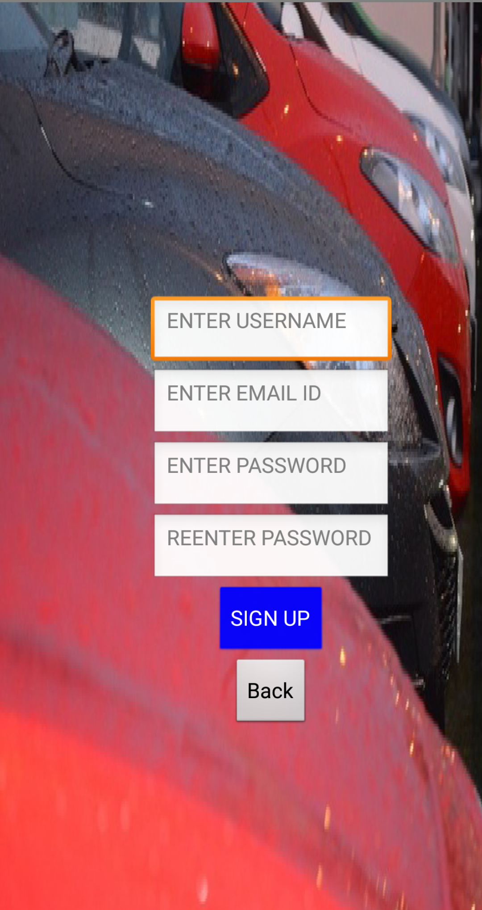
new users have to register here

Slide 6
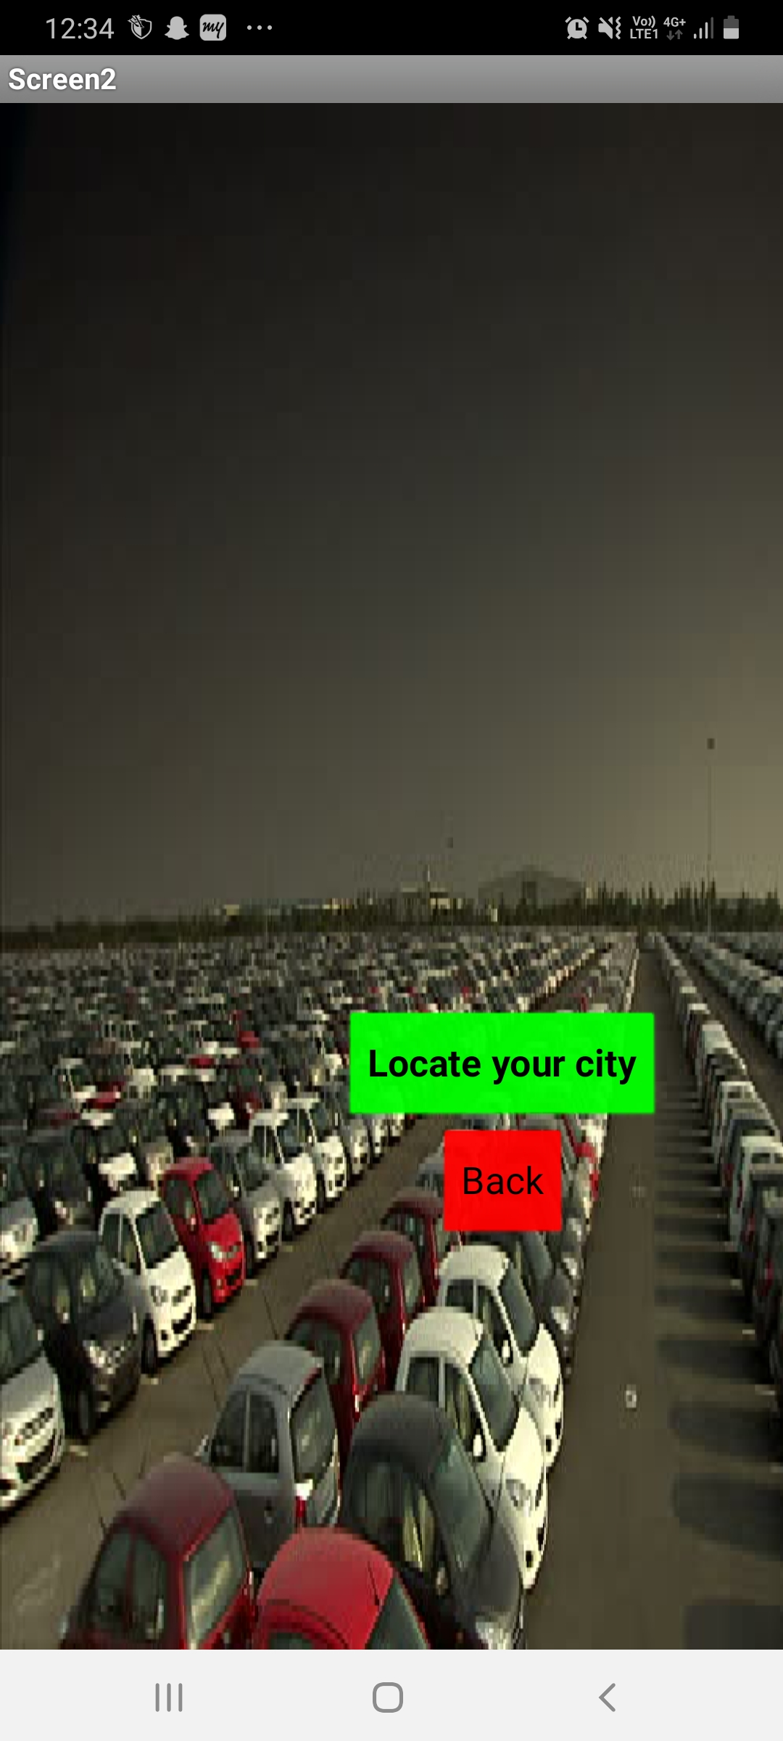
Here we have to locate city

Slide 7
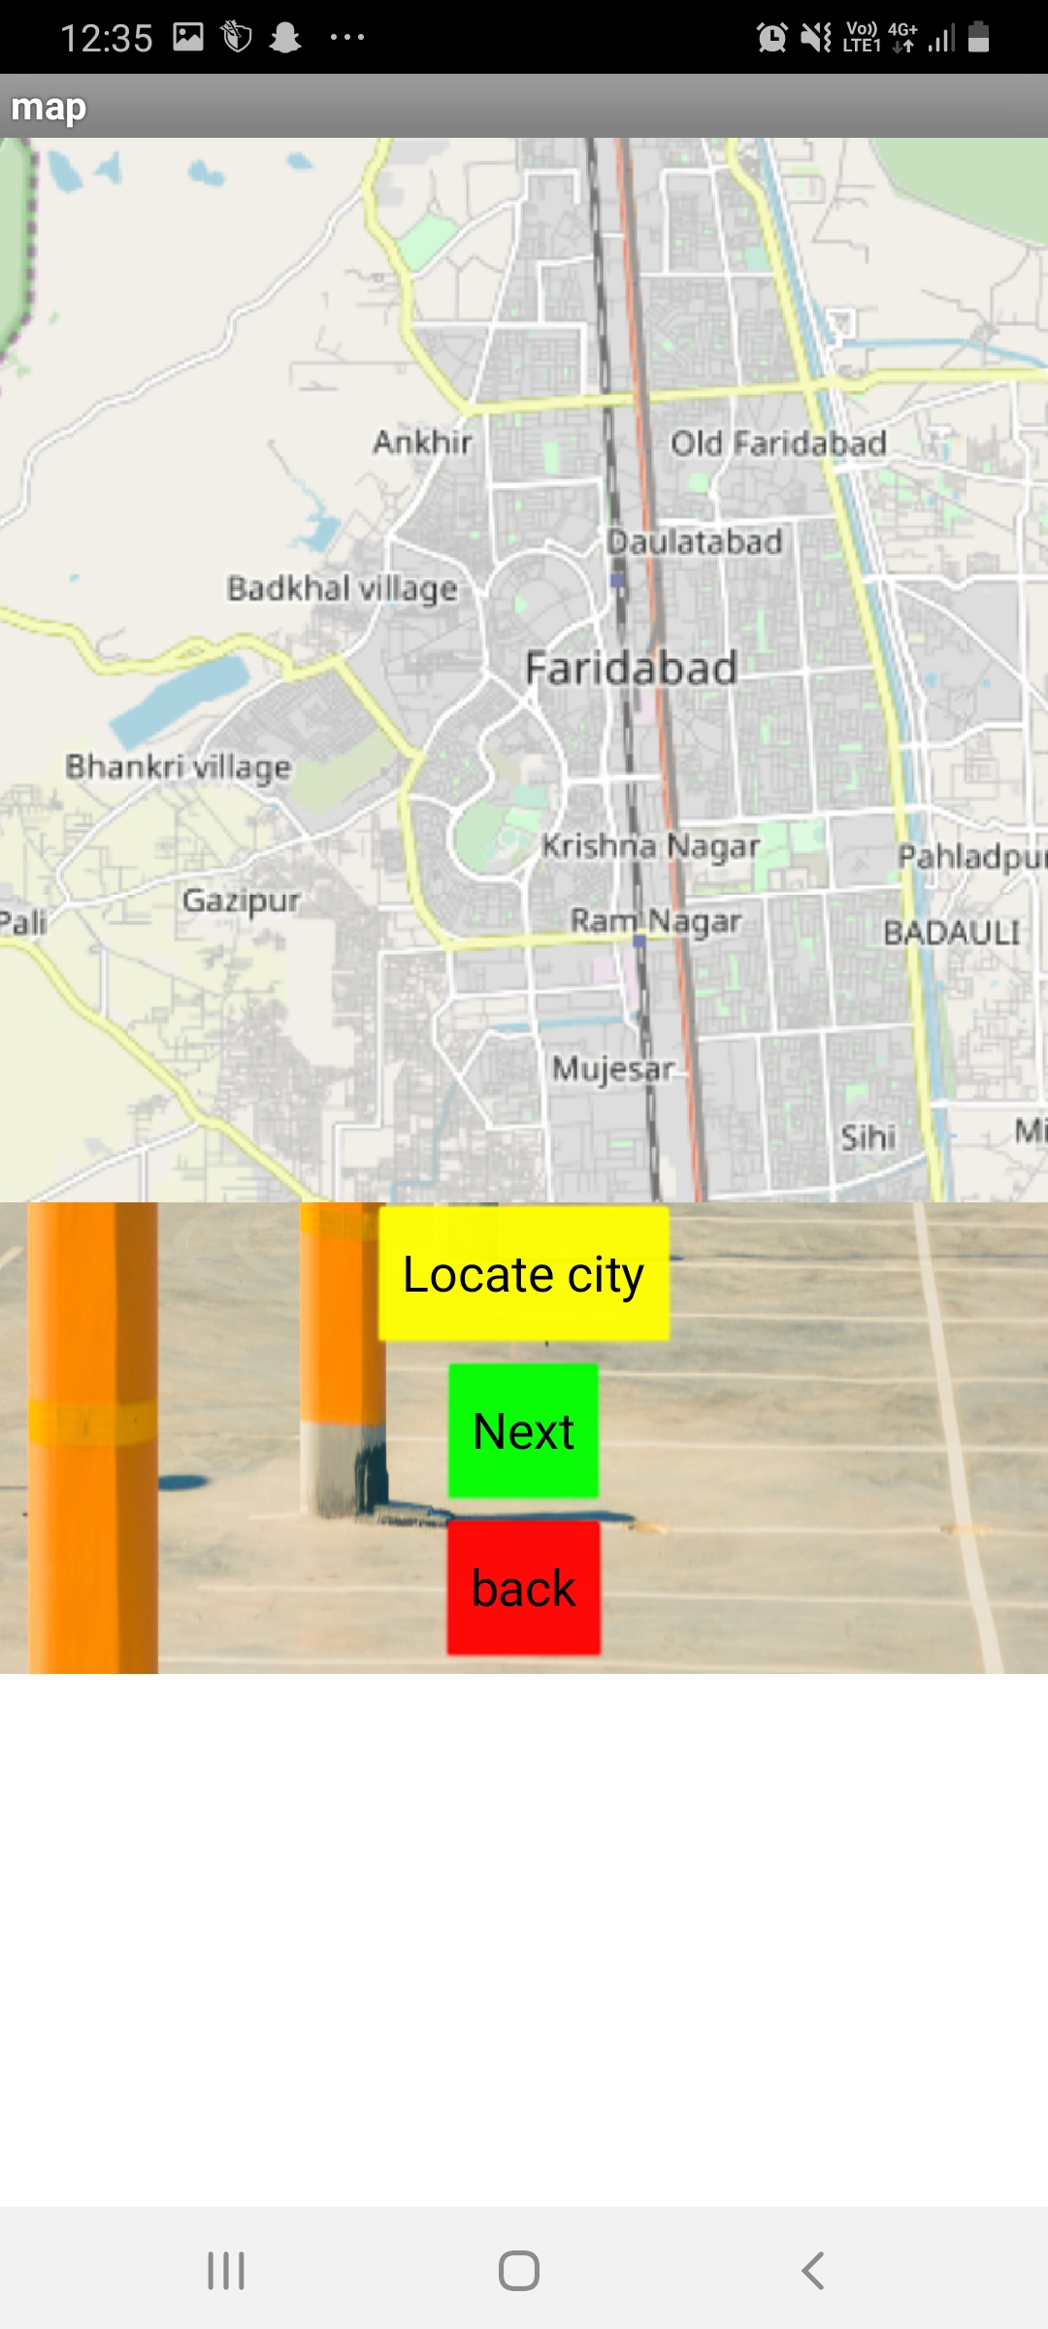
Select city

Slide 8
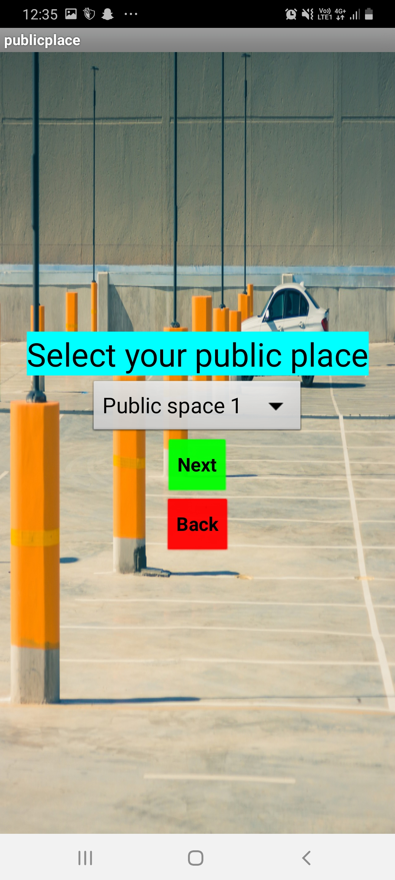
Select public place

Slide 9
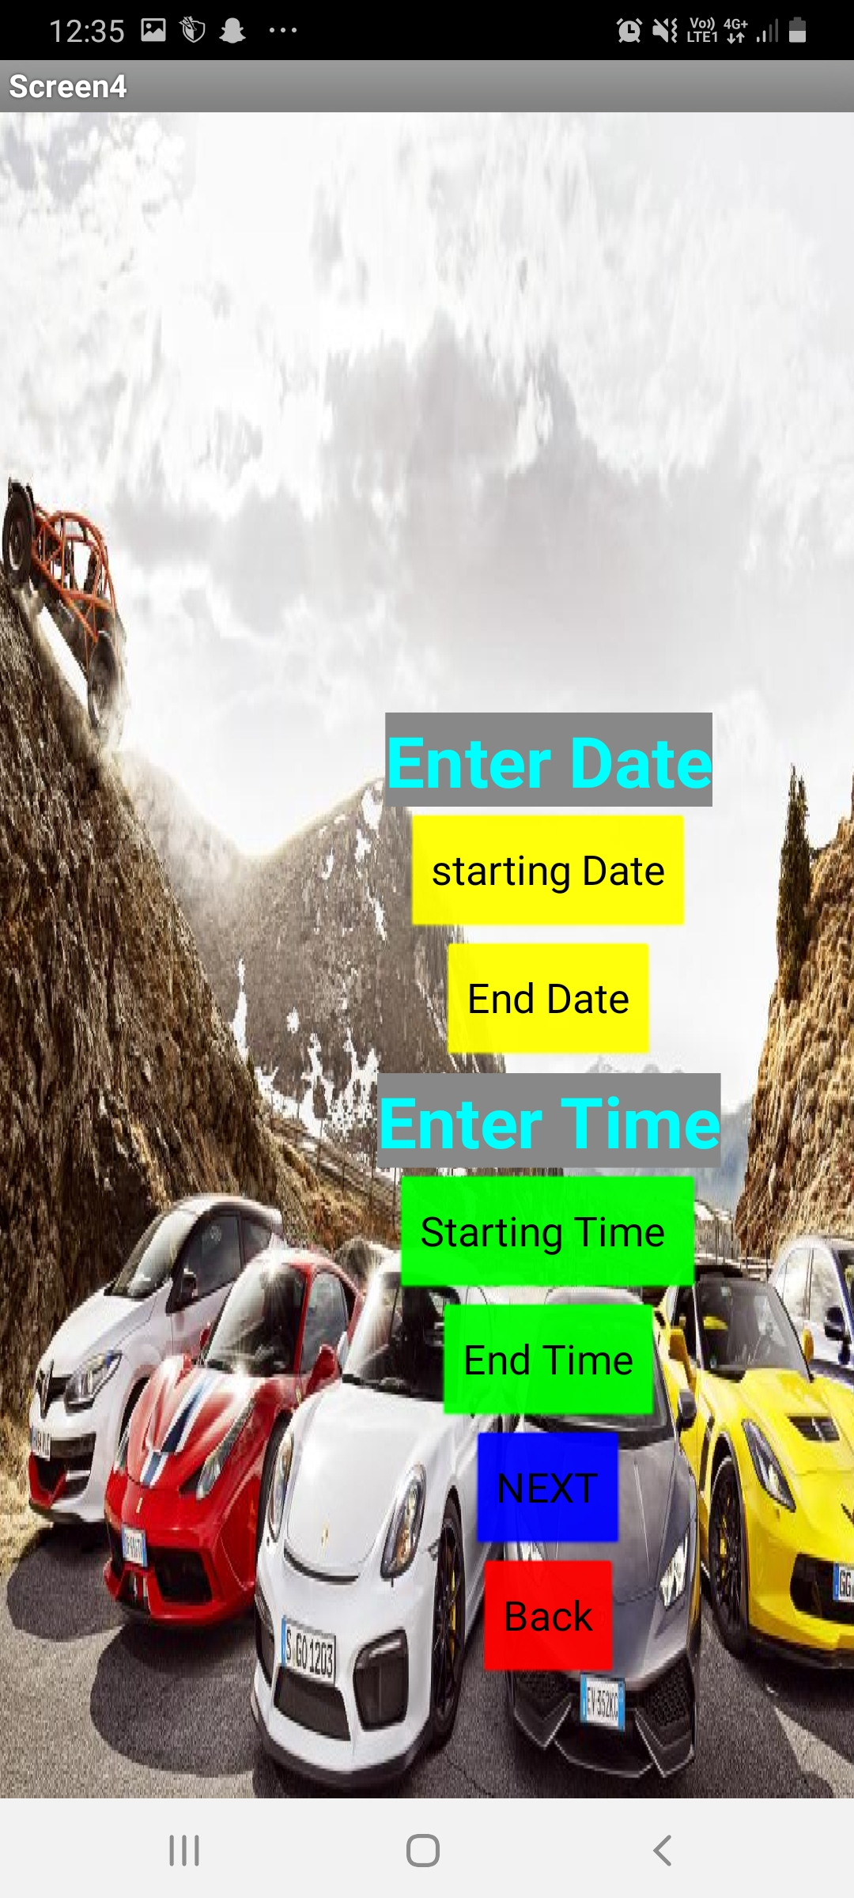
We have to enter our date and starting time and the ending time

Slide 10
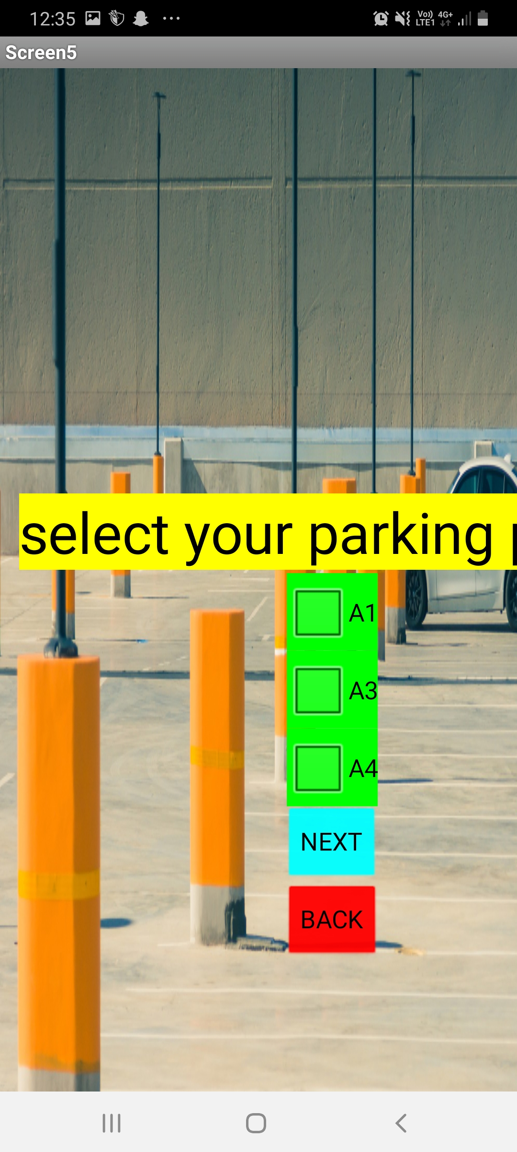
Here we can book the available slot

Slide 11
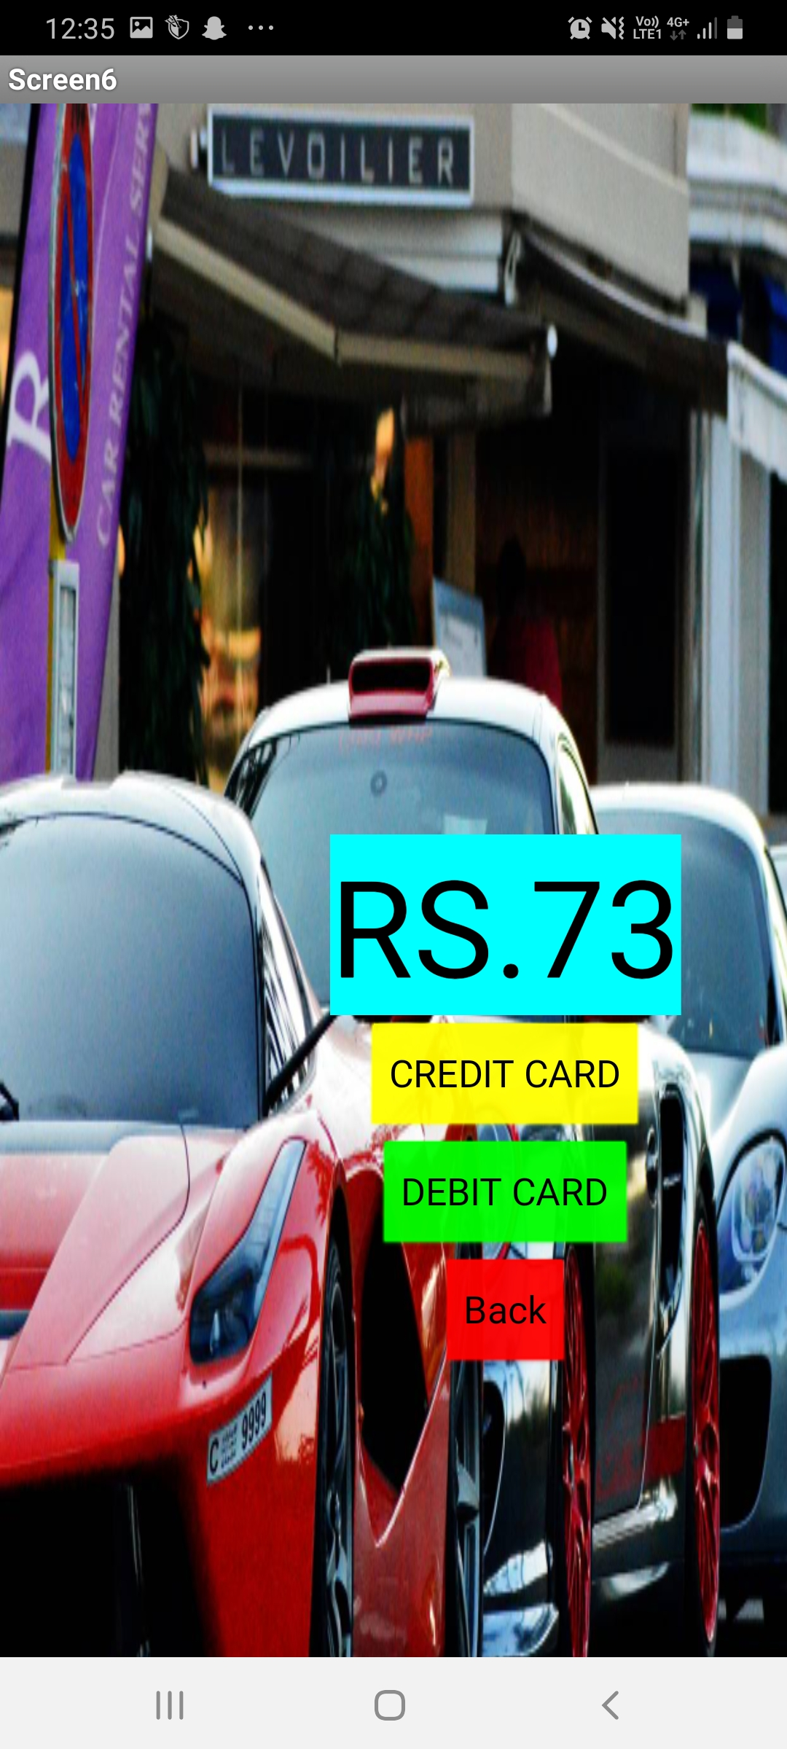
Here we have the mode of payment through credit/debit card.

Slide 12
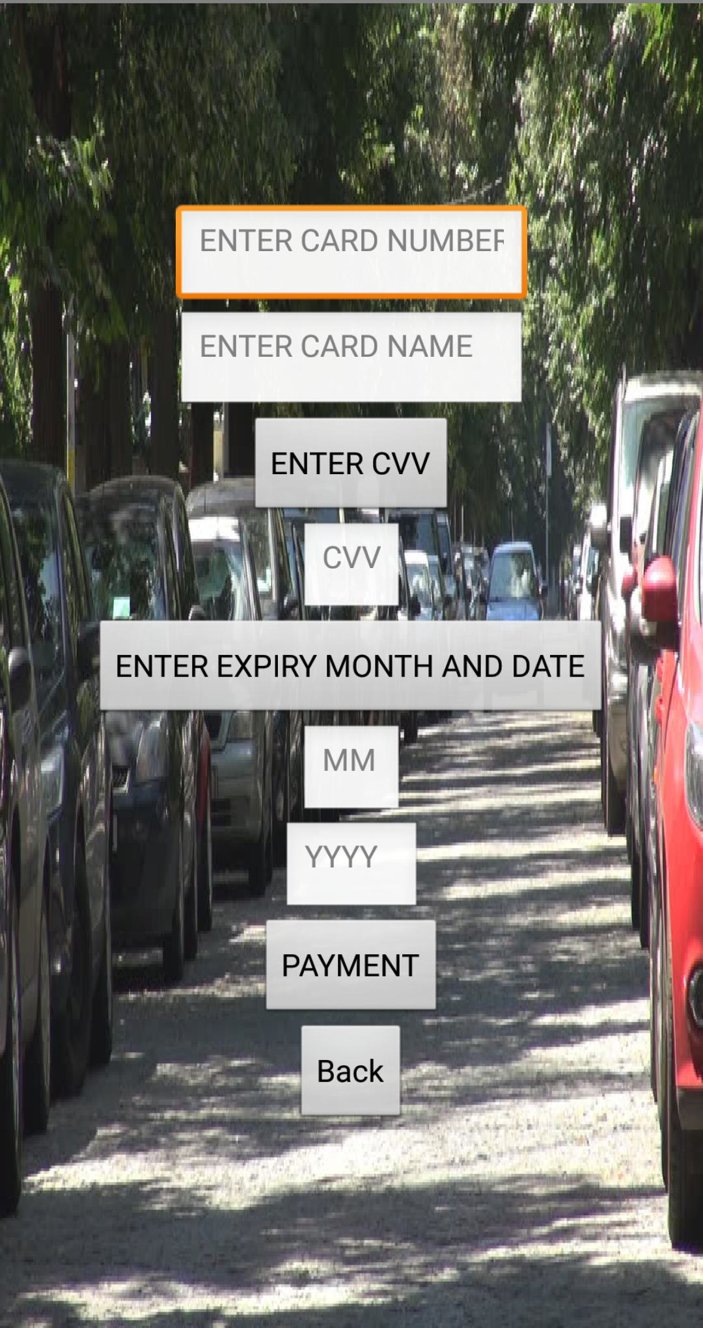
We should enter our card details.

Slide 13
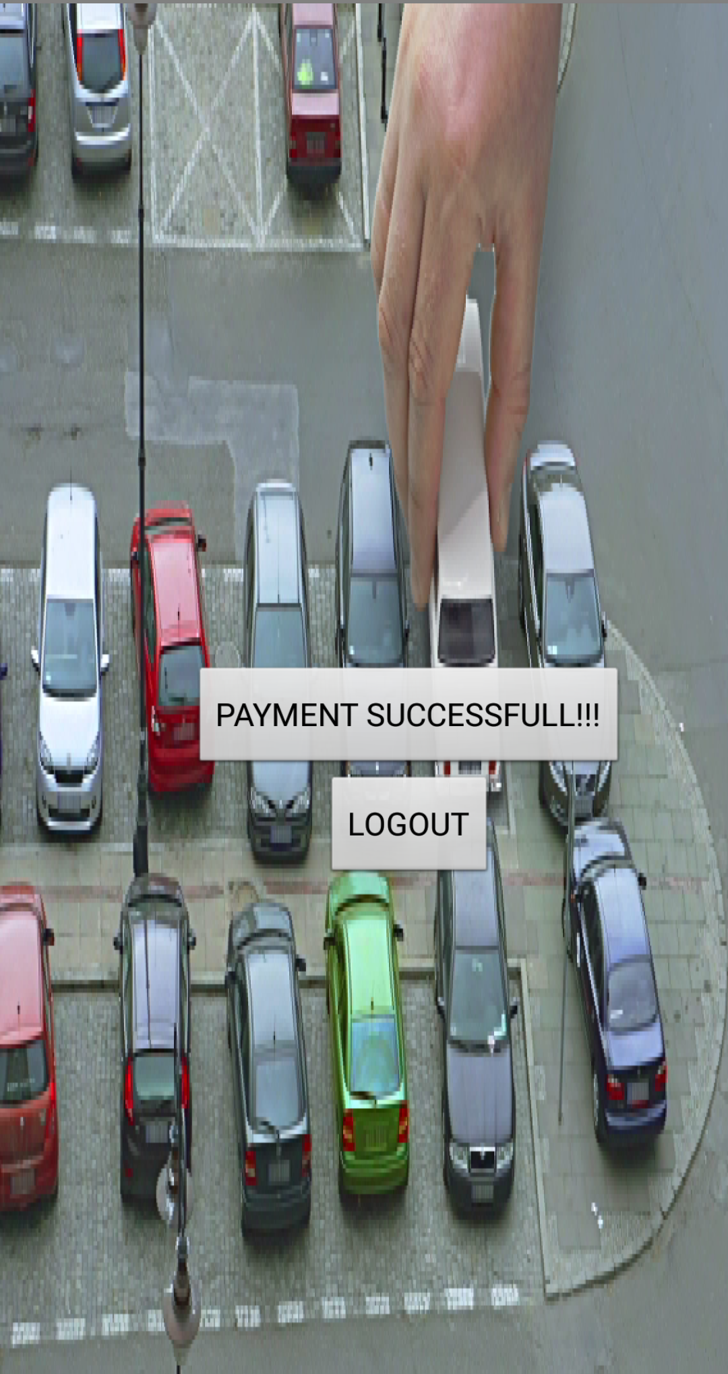
Transaction completed, Now we can park our car.

Slide 14
THANK YOU done by: 1. Vamsi Gupta 2. Jatin Manikanta 3. Pavan Kumar 4. Janardhan

